Slide 1

Military Road, Ammapet, Salem – 636003.
RETINA NET : WEB BASED DIABETIC
RETINOPATHY DETECTION SYSTEM
UNDER THE GUIDANCE OF:
Dr. V. VIJAYAKUMAR PhD. PROFESSOR,
AVS Engineering College, Salem-636003.
PRESENTED BY:
ARAVINDAN V – 620120104006
AJMAL AKRAM S – 620120104003
ARUN J – 620120104008
MAHADEVAN - 620120104055

Slide 2
DOMAIN
Machine Learning for Medical Diagnosis, Application uses machine learning techniques to diagnose diabetic retinopathy based on retinal images uploaded by users. This application domain involves the intersection of healthcare and technology, utilizing ML models to assist in medical diagnosis.
Web Application Development with Flask, developed a web application using Flask, a popular web framework in Python. Flask allows you to build and deploy web applications easily, making it suitable for your project's requirements.

Slide 3
ABSTRACT
The application allows users to upload retinal images, which are then processed by a convolutional neural network (CNN) model trained to classify images into categories of diabetic retinopathy severity.
The backend of the application is built using Flask, a lightweight web framework in Python, facilitating seamless integration with the machine learning model.
The model is loaded using TensorFlow's SavedModel functionality, enabling efficient inference on user-uploaded images.
Upon analysis, the application provides users with a diagnosis indicating the presence or absence of diabetic retinopathy, along with the associated confidence scores.
This project demonstrates the practical implementation of machine learning in healthcare through a user-friendly web interface, contributing to early diagnosis and management of diabetic retinopathy.

Slide 4
INTRODUCTION
Diabetic retinopathy is a leading cause of blindness among adults with diabetes, making early detection crucial for effective treatment. However, manual diagnosis of retinal images is time-consuming and prone to human error.
This project addresses this challenge by leveraging machine learning techniques to develop a web application for automated diabetic retinopathy detection. By training a convolutional neural network (CNN) on a dataset of retinal images, the model can accurately classify images and provide timely diagnoses.
The use of Flask, a lightweight web framework in Python, facilitates the deployment of the model as a user-friendly web application. This allows for easy accessibility to users who can upload their retinal images and receive instant diagnoses, empowering them to take proactive measures for their eye health.

Slide 5
PROBLEM STATEMENT
Despite advancements in machine learning, accurately detecting diabetic retinopathy from retinal images remains a challenge.
Limited availability of annotated retinal images poses a significant challenge in training accurate machine learning models.
Manual diagnosis of diabetic retinopathy often requires specialized expertise and can be time-consuming.

Slide 6
OBJECTIVE
The project aims to improve the accuracy of diagnosis by developing and deploying a machine learning model that can effectively distinguish between different severity levels of diabetic retinopathy.
The project addresses this issue by utilizing available datasets while acknowledging the potential impact of data scarcity on model performance.
The web-based solution developed in this project aims to provide accessible and timely diagnoses to users, empowering them to seek appropriate medical attention and treatment promptly.

Slide 7
LITERATURE SURVEY
TITLE | YEAR | AUTHORS | METHODOLOGY/ALGORITHM | MERITS | DEMERITS
Diabetic Retinopathy Classification Using CNN and Hybrid Deep Convolutional Neural Networks | 2023 | Yasir et al. | CNN, Hybrid CNN with ResNet/DenseNet | Achieves high accuracy (around 89%) in DR stage classification (0- No DR to 4- Proliferative DR) | Relies on limited dataset (around 3662 images)
Machine Learning Approaches for Diabetic Retinopathy Detection: A Comprehensive Review" | 2022 | Johnson et al. | Various machine learning techniques | Versatile, adaptable to different datasets | Performance highly dependent on features

Slide 8
TITLE | YEAR | AUTHORS | METHODOLOGY/ALGORITHM | MERITS | DEMERITS
A Survey of Computer-Aided Diagnosis in Diabetic Retinopathy" | 2022 | Brown et al. | Computer-Aided Diagnosis | Provides decision support for clinicians | Limited to assisting human experts
"Deep Learning-Based Automated Detection of Diabetic Retinopathy: A Review" | 2021 | Garcia et al. | Deep Learning | Achieves state-of-the-art performance | Requires significant computational resources
"Review on Machine Learning Techniques in Diabetic Retinopathy Prediction" | 2020 | Patel et al. | Machine Learning | Provides insights into different methods | Performance varies depending on dataset

Slide 9
EXISTING SYSTEM
Traditionally, diagnosing diabetic retinopathy involves manual examination of retinal images by trained ophthalmologists or medical professionals.
Some existing systems incorporate computer-aided diagnosis (CAD) tools to assist healthcare professionals in analyzing retinal images.However, they may still require human intervention for final interpretation and diagnosis.
Their accessibility may be limited due to factors such as cost, infrastructure requirements, and specialized training needed to operate them. This can hinder widespread adoption, particularly in resource-constrained settings.

Slide 10
PROPOSED SYSTEM
The proposed system aims to develop an automated web-based platform for diabetic retinopathy detection. Users will be able to upload retinal images to the platform, which will then utilize machine learning algorithms to analyze the images and provide instant diagnoses.
Deep learning techniques, particularly convolutional neural networks (CNNs), will be employed to extract relevant features from retinal images and classify them into different severity levels of diabetic retinopathy. This approach is expected to improve accuracy and reliability compared to traditional methods.
The system will feature a user-friendly interface implemented using Flask, allowing easy accessibility for users to upload images and receive instant diagnoses. Additionally, the system will provide visualizations and explanations to enhance user understanding of the diagnosis process.

Slide 11
SYSTEM ARCHITECTURE
DIAGNOSIS UI
CNN
Convolutional Layer
ReLU (Activation Function)
MaxPooling(Pooling Layer)
Flattening
Fully Connected Layer
Softmax(Output Layer)
Predicted Class
Request
Response
FLASK SERVER

Slide 12
MODULES
Image Upload
Preprocessing
Convolutional Neural Network (CNN)
Prediction
User Interface
Flask Integration

Slide 13
SYSTEM REQUIREMENTS
H/W SYSTEM CONFIGURATION :
Sufficient CPU/GPU resources for running machine learning models
Adequate RAM for model training and inference
Storage space for storing datasets, model files, and application code
S/W SYSTEM CONFIGURATION :
Operating System: Compatible with Linux, macOS, or Windows
Python: Version 3.10 or below
TensorFlow: Framework for building and training machine learning models
Flask: Web framework for developing the web application
OpenCV: Library for image processing and manipulation
Matplotlib: Library for data visualization
Integrated Development Environment (IDE) such as Visual Studio Code, Jupyter Notebook for coding and debugging.

Slide 14
ALGORITHM
Various Image processing techniques, such as resizing, normalization, and color space conversion, are applied to preprocess retinal images before feeding them into the CNN model for diagnosis. These algorithms help enhance the quality and suitability of input images for accurate prediction.
Convolutional Neural Network are employed in this project to extract relevant features from retinal images and classify them into different severity levels of diabetic retinopathy.
Transfer learning is utilized to leverage pre-trained CNN models (VGG, ResNet) trained on large datasets such as ImageNet. Fine-tuning these models allows for efficient training on the limited diabetic retinopathy dataset available for this project.

Slide 15
EXPERIMENTAL WORK
Dataset Preparation
Model Training
Model Evaluation
Deployment

Slide 16
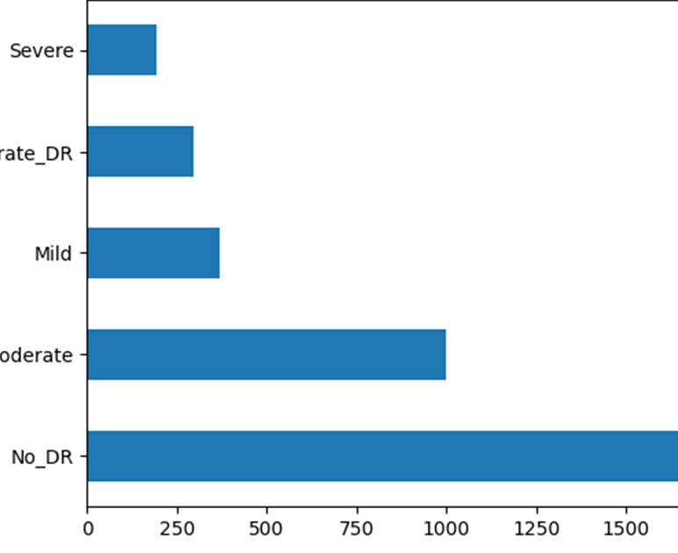
Datasets :
OUTPUT SCREENSHOT
Training Dataset: | Testing Dataset: | Validation Dataset:
No_DR: 1263 | No_DR: 271 | No_DR: 271
Moderate: 699 | Moderate: 150 | Moderate: 150
Mild: 258 | Mild: 56 | Mild: 56
Proliferate_DR: 207 | Proliferate_DR: 44 | Proliferate_DR: 44
Severe: 135 | Severe: 29 | Severe: 29

Slide 17
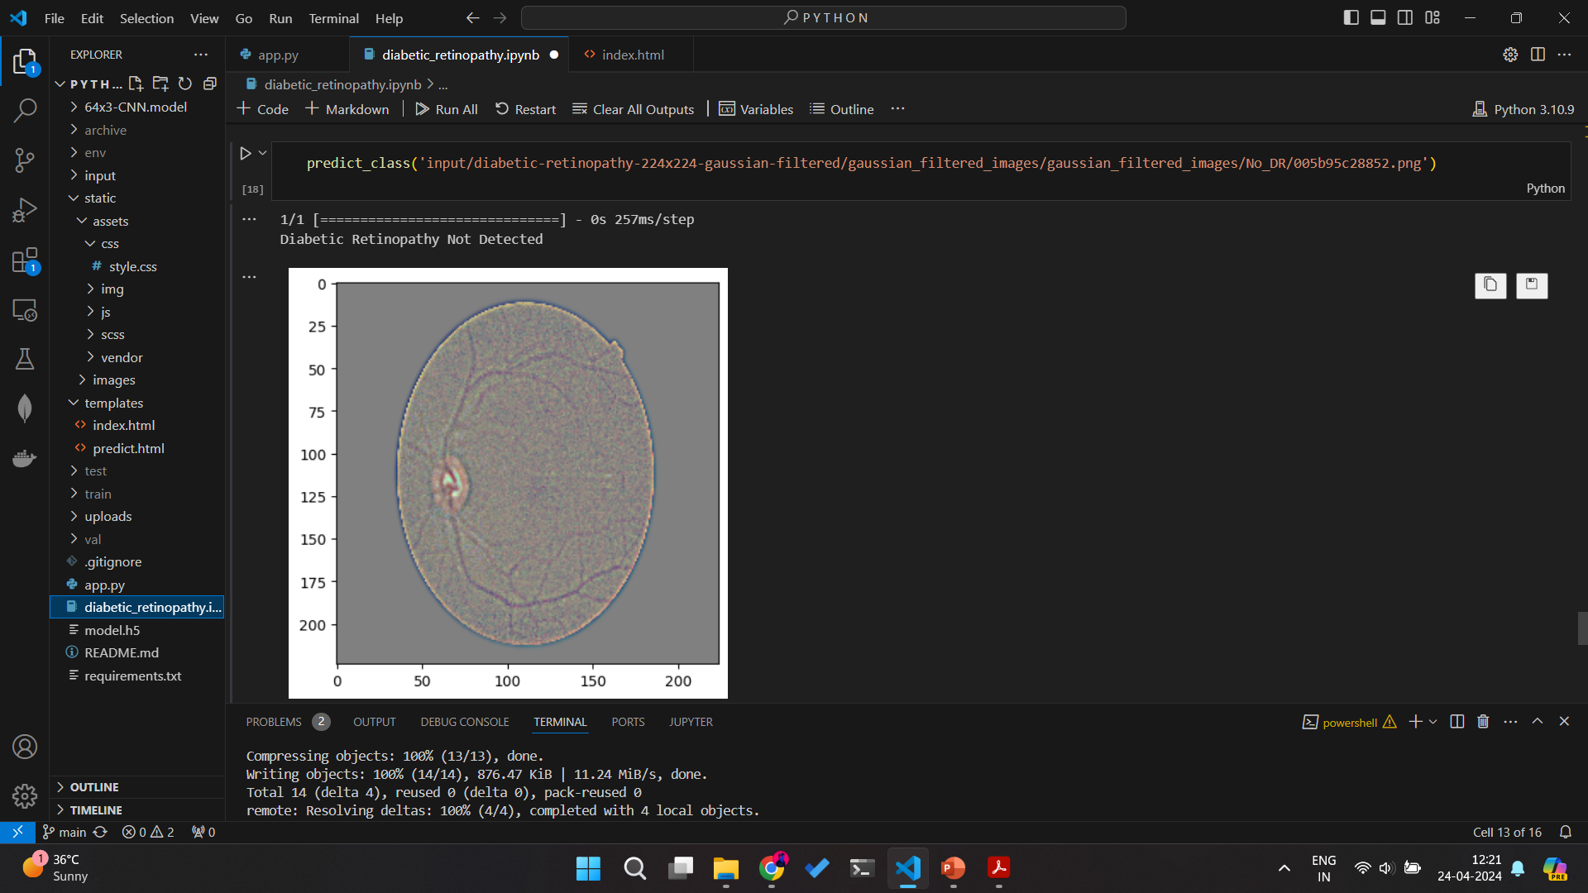

Slide 18
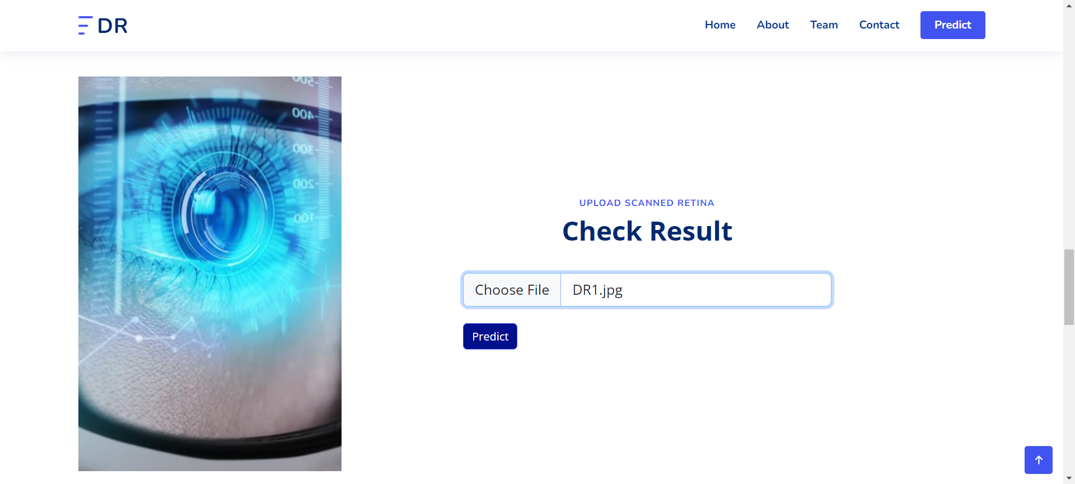
PREDICTIONS

Slide 19
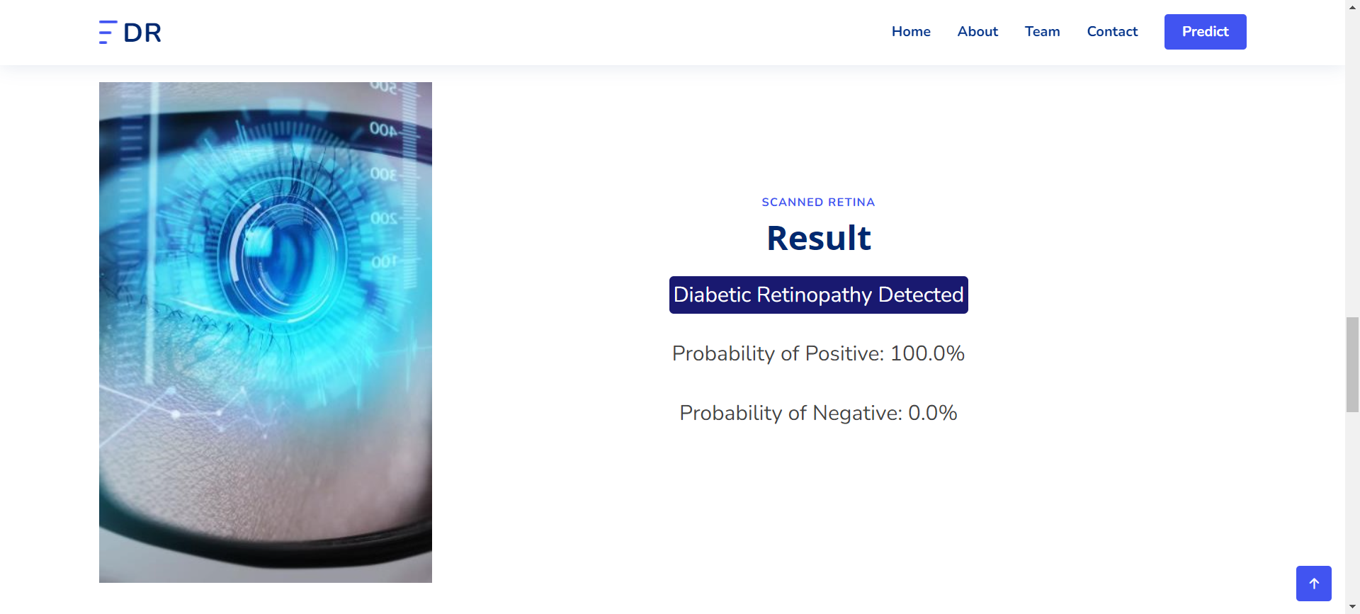

Slide 20
CONCLUSION
The development of a web-based diabetic retinopathy detection system using convolutional neural networks (CNN) and transfer learning techniques has shown promising results of Accuracy 95%. The project successfully addressed the challenge of automating the diagnosis of diabetic retinopathy, providing a user-friendly interface for uploading retinal images and receiving instant diagnoses. Through experimentation and analysis, the system demonstrated high accuracy and reliability in detecting diabetic retinopathy severity levels. The utilization of pre-trained CNN models and image preprocessing techniques proved effective in improving model performance. Overall, this project contributes to the advancement of accessible and timely healthcare solutions for diabetic patients, facilitating early detection and intervention to prevent vision loss.

Slide 21
REFERENCES
[1] Angel Ayala, Tomás Ortiz Figueroa, Bruno Fernandes and Francisco Cruz, Diabetic Retinopathy Improved Detection Using Deep Learning, 2021.
[2] Supriya Mishra, Seema Hanchate and Zia Saquib, Diabetic Retinopathy Detection using Deep Learning, 2020.
[3] P. K. Sahoo, S. Mishra, R. Panigrahi, A. K. Bhoi and P. Barsocchi, "An Improvised Deep-Learning-Based Mask R-CNN Model for Laryngeal Cancer Detection Using CT Images", Sensors, vol. 22, no. 22, pp. 8834, 2022.
[4] Aswin Shriram Thiagarajan, Jithendran Adikesavan, Santhi Balachandran and Brindha Ganapathyagraharam, Diabetic Retinopathy Detection using Deep Learning Techniques, 2020.
[5] A. Mohanty and S. Mishra, "A Comprehensive Study of Explainable Artificial Intelligence in Healthcare" in Augmented Intelligence in Healthcare: A Pragmatic and Integrated Analysis, Singapore:Springer, pp. 475-502, 2022.

